Slide 1
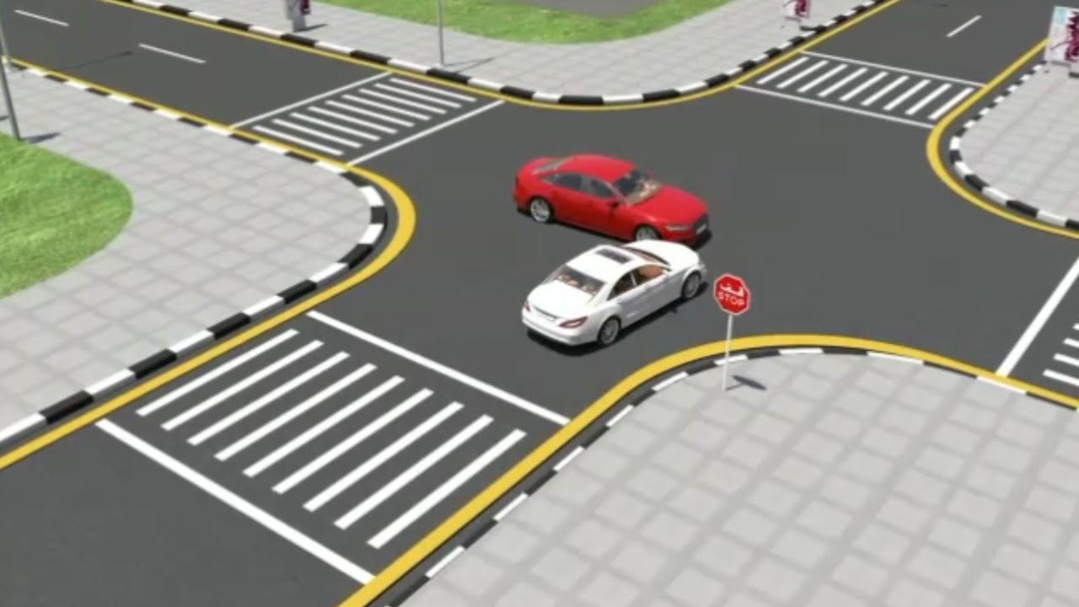
Cross-Traffic Management
Members : Mehedi Hasan Masrur Jamil Prochchhod Pisula Guruge

Slide 2

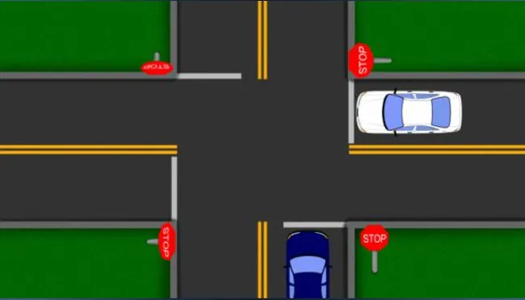
Motivation

Slide 3
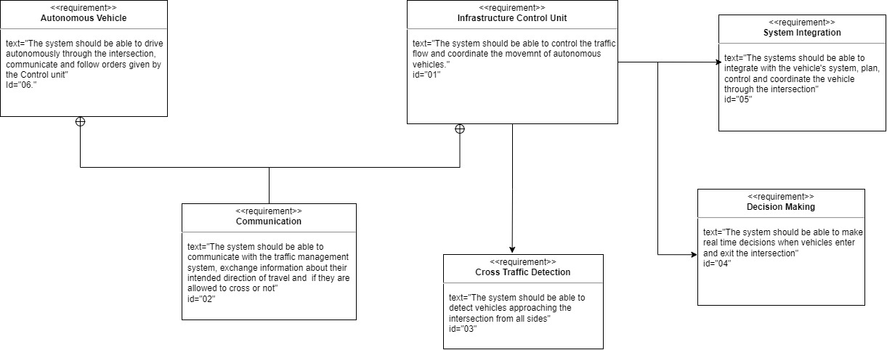
REQUIREMENT DIAGRAMS

Slide 4
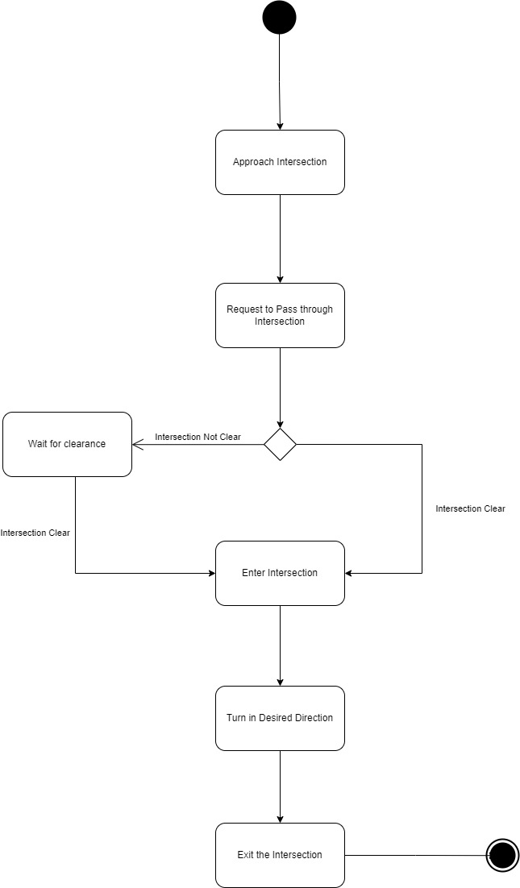
ACTIVITY DIAGRAM

Slide 5
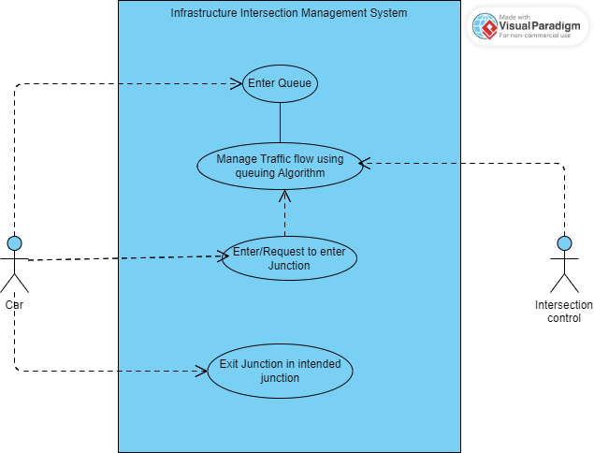
USE CASE DIAGRAM

Slide 6
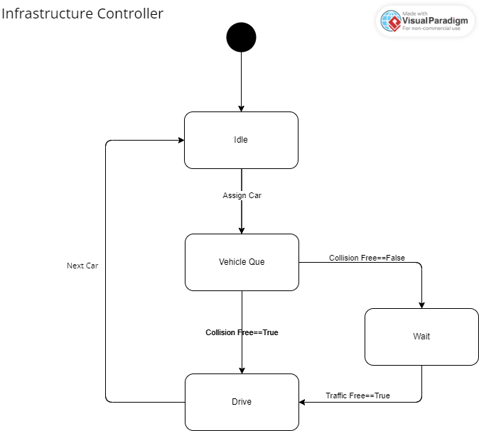
STATE MACHINE DIAGRAM

Slide 7
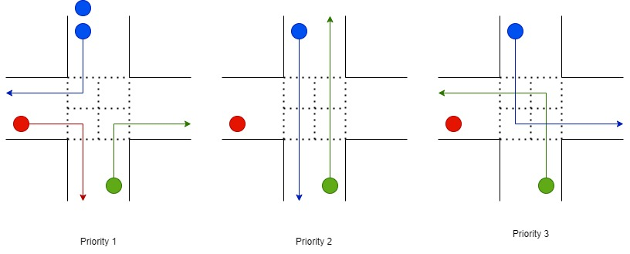
SCEHDULING ALGORITHM

Slide 8
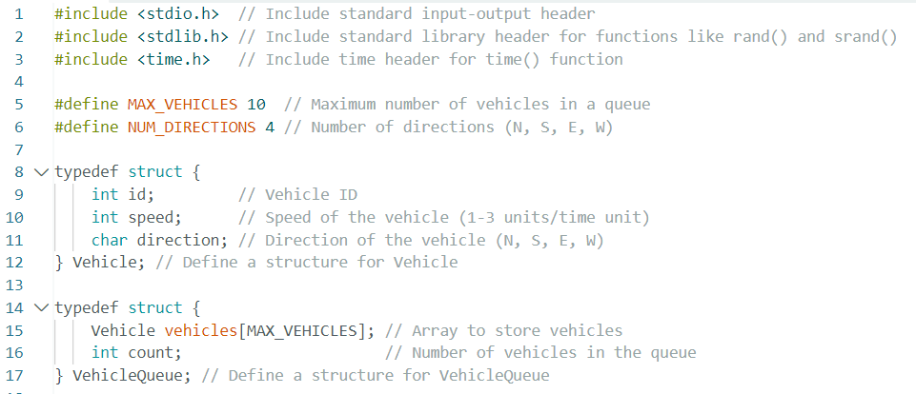
IMPLEMENTATION IN C

Slide 9
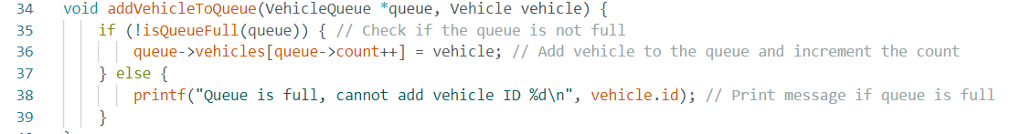
IMPLEMENTATION IN C

Slide 10
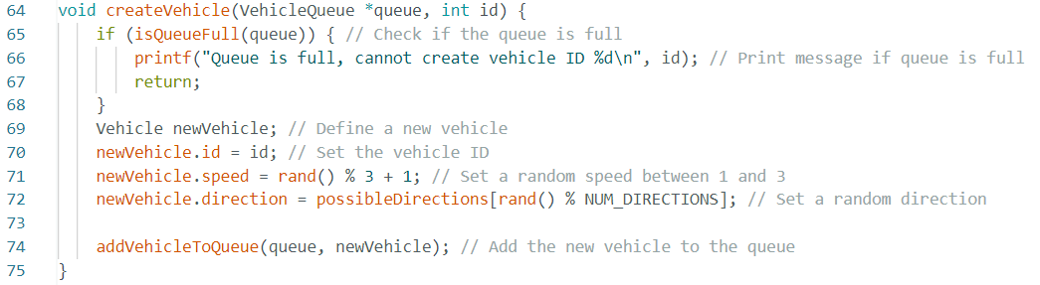
IMPLEMENTATION IN C

Slide 11
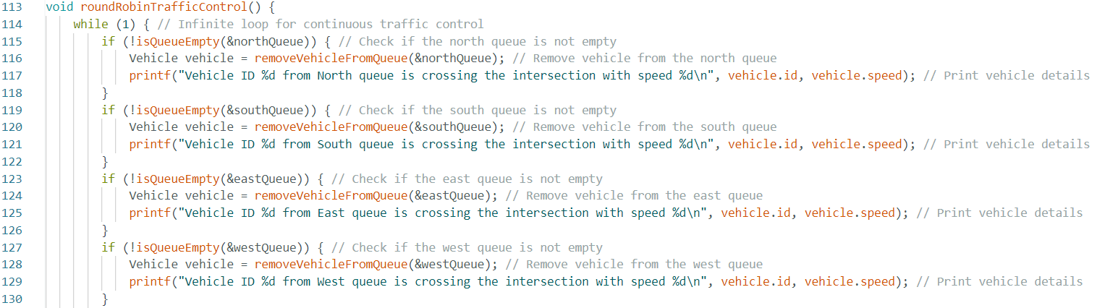
IMPLEMENTATION IN C

Slide 12
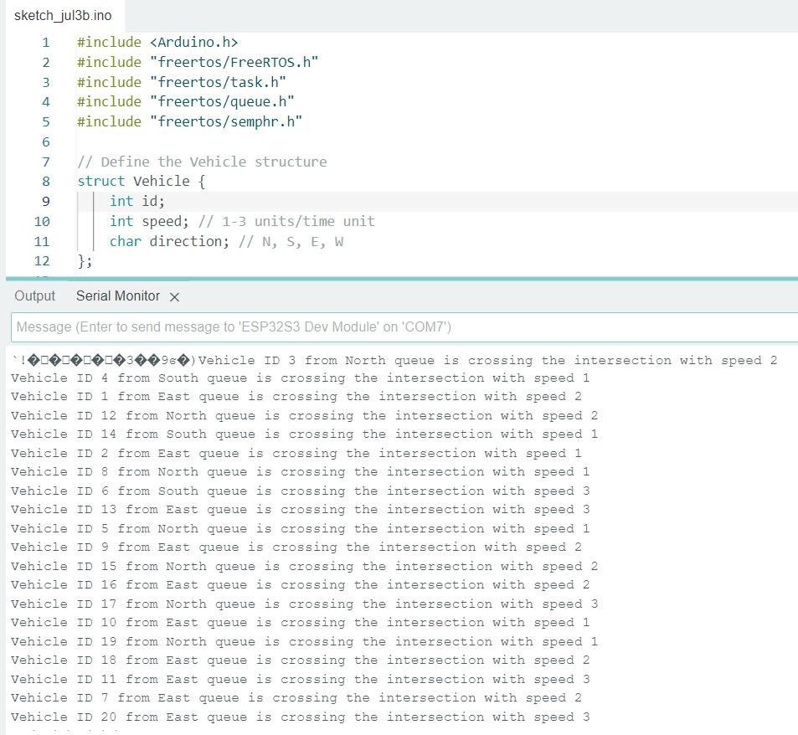
FREERTOS

Slide 13
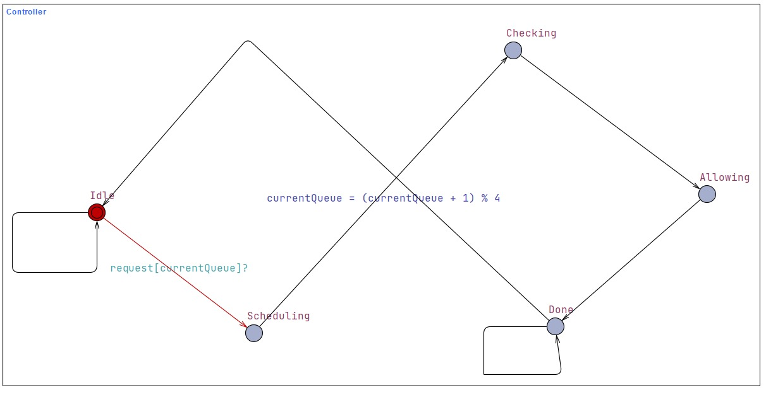
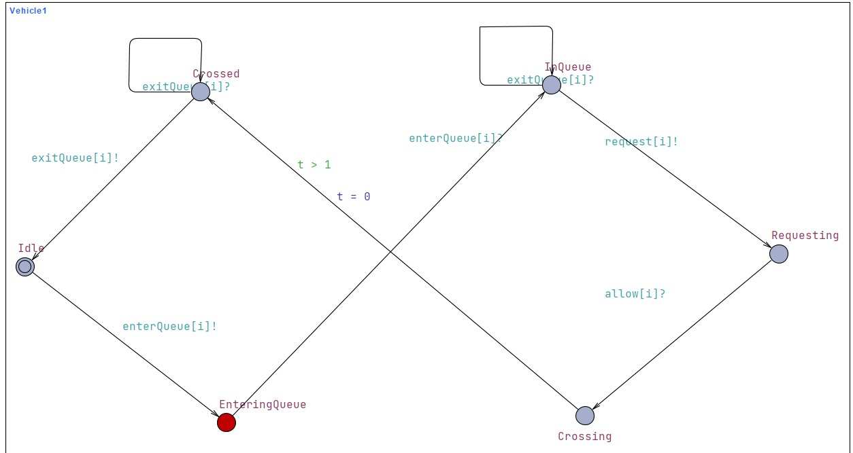
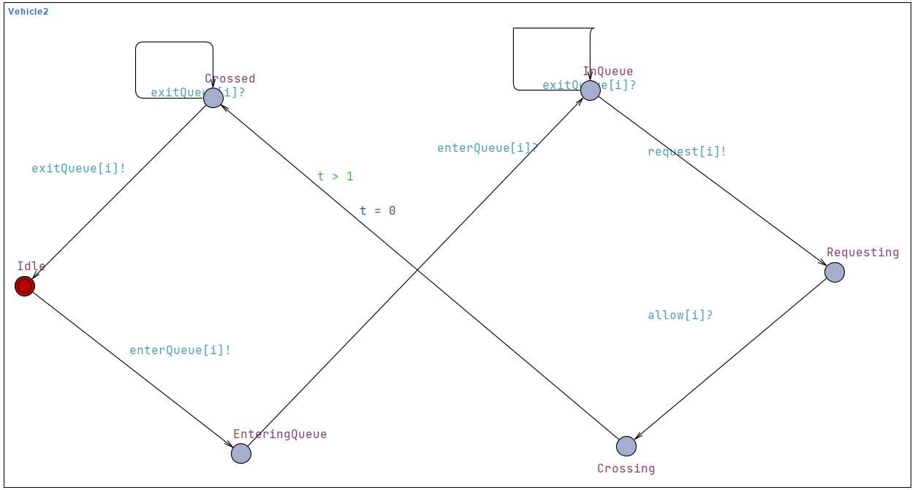
UPPAAL DIAGRAM

Slide 14
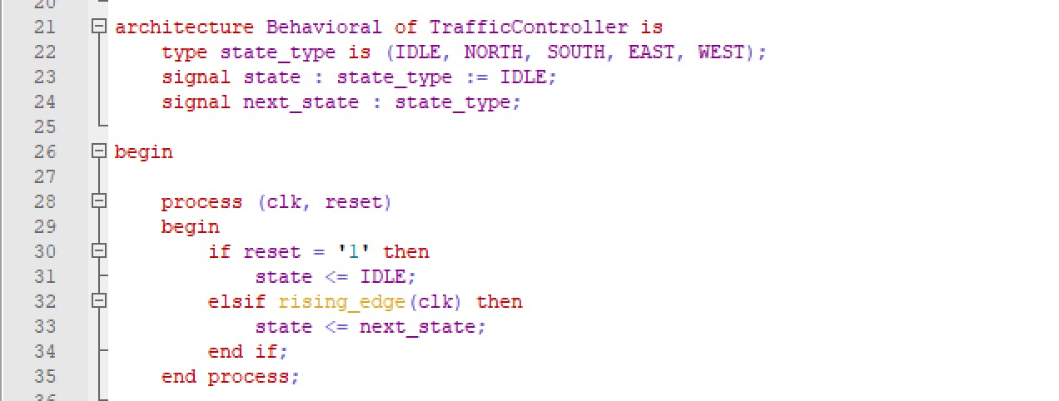
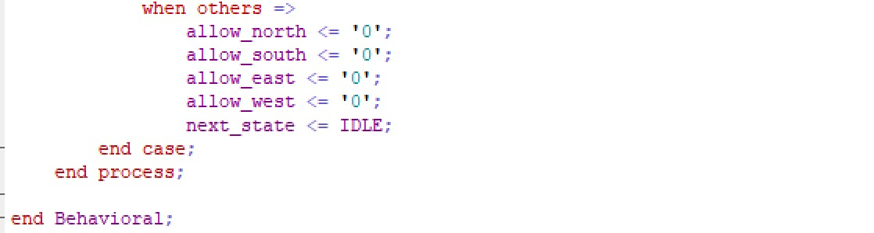
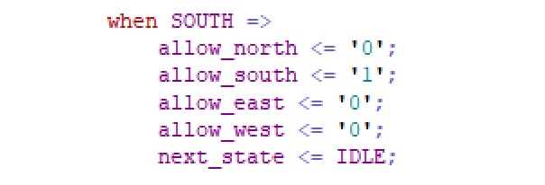
VHDL

Slide 15
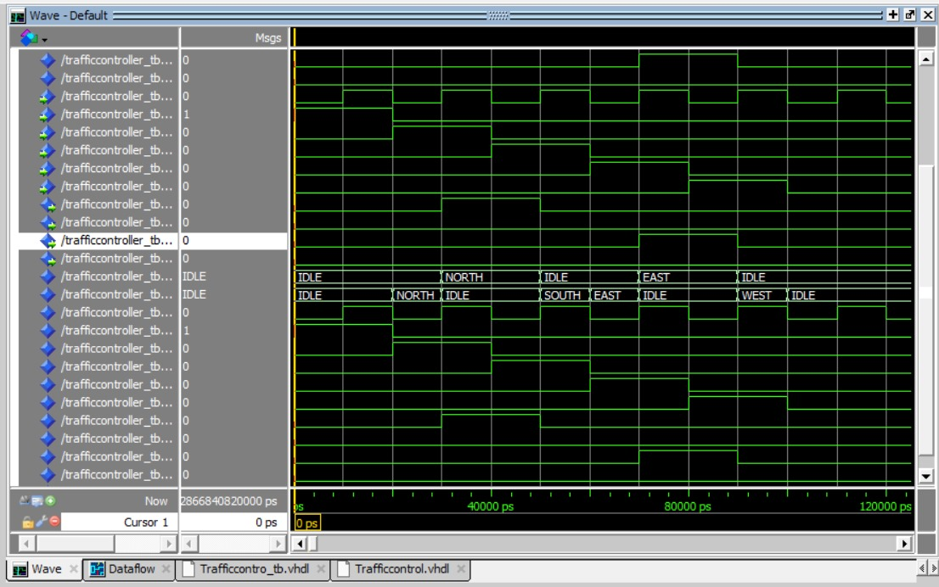
MODELSIM

Slide 16
Thank You

